Slide 1
CSF 2113 Programming for Information Security
Resource Discovery (CLO 04)
Muhammad Humayoun, PhD
Assistant Professor
mhumayoun@hct.ac.ae
Abu Dhabi Men’s College
This module is based on the course: Learning Python Web Penetration Testing, www.lynda.com

Slide 2
Table of Contents
Fuzzing
Resource Discovery
Creating the bruteforcer
Improving the result analysis
Automatic screenshots of results

Slide 3
What is Fuzzing?
Fuzz testing (fuzzing) is a Black Box software testing technique used to discover coding errors and security loopholes in software, operating systems or networks.
It involves inputting massive amounts of random data, called fuzz, to the test subject in an attempt to make it crash.
If a vulnerability is found, a software tool called a fuzzer can be used to identify potential causes.
Simple, but offers a high benefit-to-cost ratio and can often reveal serious defects that are overlooked when software is written and debugged.

Slide 4
What makes Fuzzing possible?
User errors
Fuzzing is only useful against a system which:
improperly sanitize input
take more data than it can handle
Sanitizing input: checking user input before storing it in a database or using it for any other purpose to prevent malicious code injection.
Three important Fuzzing tasks that we’ll cover:
Resource Discovery Week 12-13
Password Cracking Week 12-13
SQL Injections Week 14-15

Slide 5
What is Resource Discovery
Discovering what resources are available in the application
A process of building a map or catalog of the application pages and functionalities
How: Dictionary attacks, Brute forcing

Slide 6
Building the first brute forcer for resource discovery using a dictionary of words
Dictionary of words
The most commonly used resources in web applications. These dictionaries are plenty (we’ll use common.txt, commons.txt)
Define the objective of the tool
Make web links using dictionary http://somewebsite/admin (word admin comes from the dictionary)
Find out which pages, files, directories are found using http statuscode 200
Run it against our test web application
The scruffy bank application running at localhost (127.0.0.1)

Slide 7
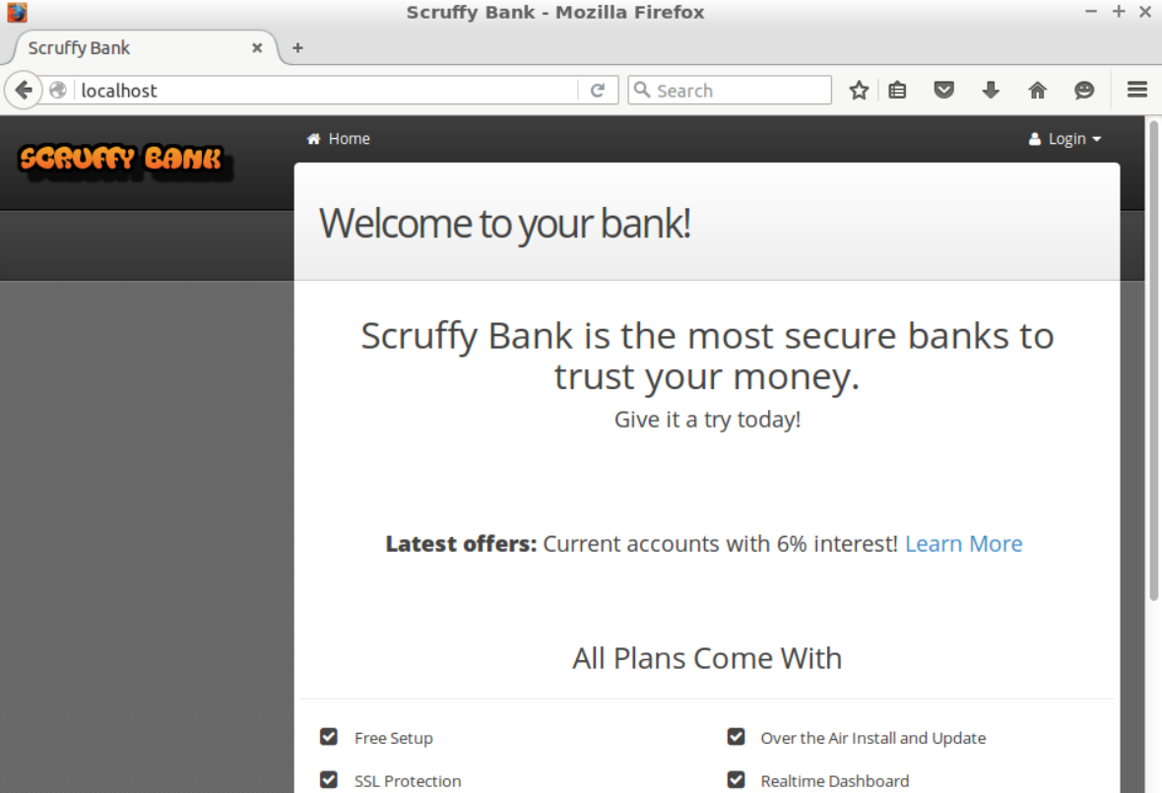

Slide 8
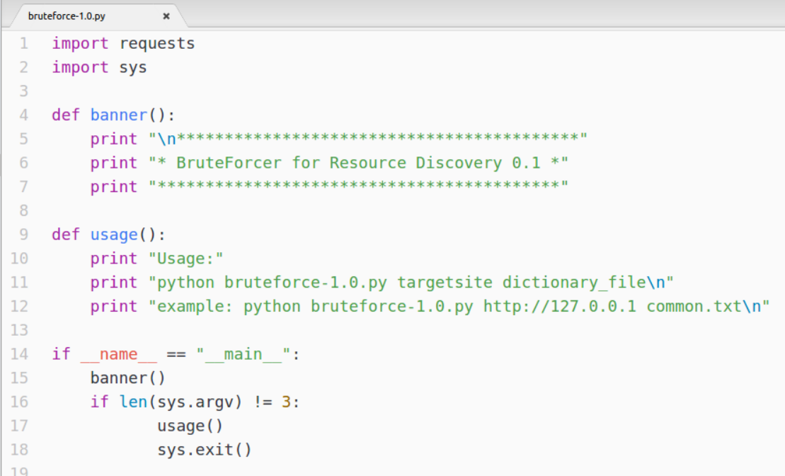
Step 1: bruteforce-1.0.py – building the basic command line structure
Request library from web request
sys library from getting command line arguments
Defining the main function of our application
If arguments passed on the console are not 3
Print usage function and exit

Slide 9
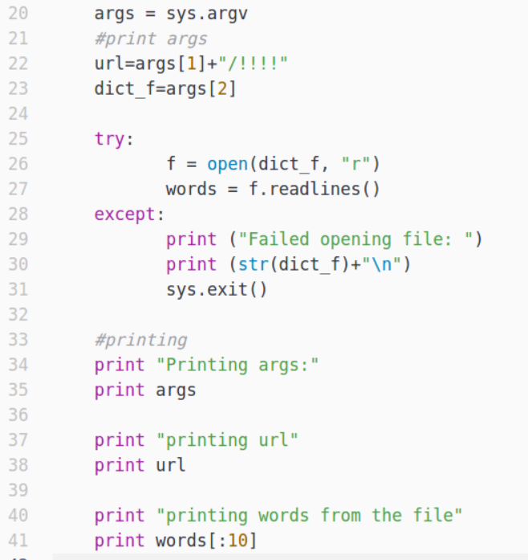
Get command line arguments
Add /!!!! to the url why?
We’ll replace !!!! with dictionary words later
Printing first ten dictionary words for debugging

Slide 10
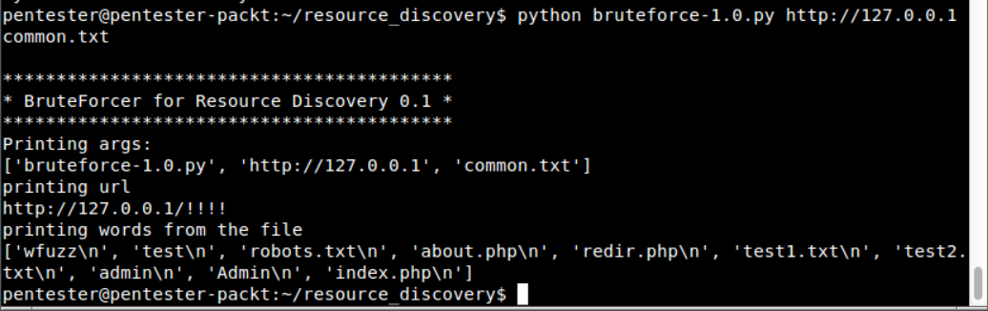
Step 1: bruteforce-1.0.py – Output
words is a list of words
Need to remove \n

Slide 11
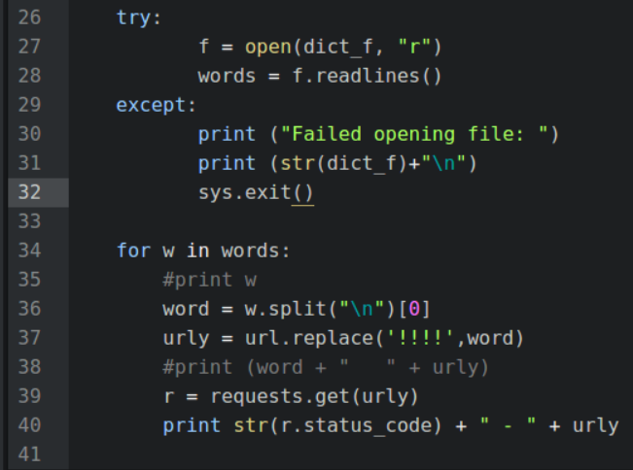
Step 2: bruteforce-1.1.py – Read words from dictionary one by one, make links and get those pages using Request library
words is a list of words
Need to remove \n
w is a single word
Need to remove \n
w.split(“\n”) returns a list with two elems: [“word”, “”] get val at 0
url contains: http://127.0.0.1/!!!!
Replace !!!! With word
e.g. http://127.0.0.1/wfuzz
2nd time: http://127.0.0.1/test
And so on …
Get the page
r.status_code contains its status code

Slide 12
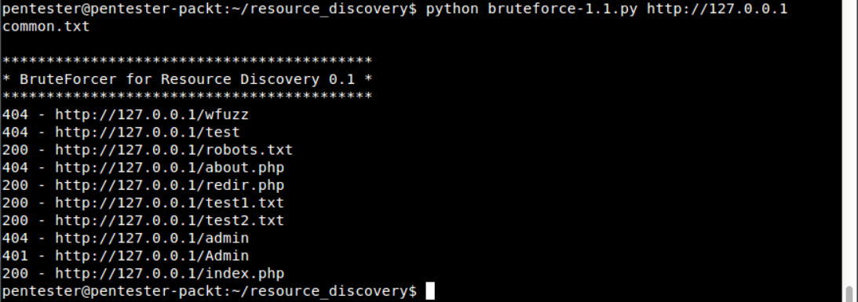
Step 2: bruteforce-1.1.py – Output
Try commons.txt instead of common.txt
commons.txt is a very large file. There will be a lot more results with status code 404 (Page not found)
We are only interested in those links for which a page is found
So it seems better not to print those links with 404 status code for readability

Slide 13
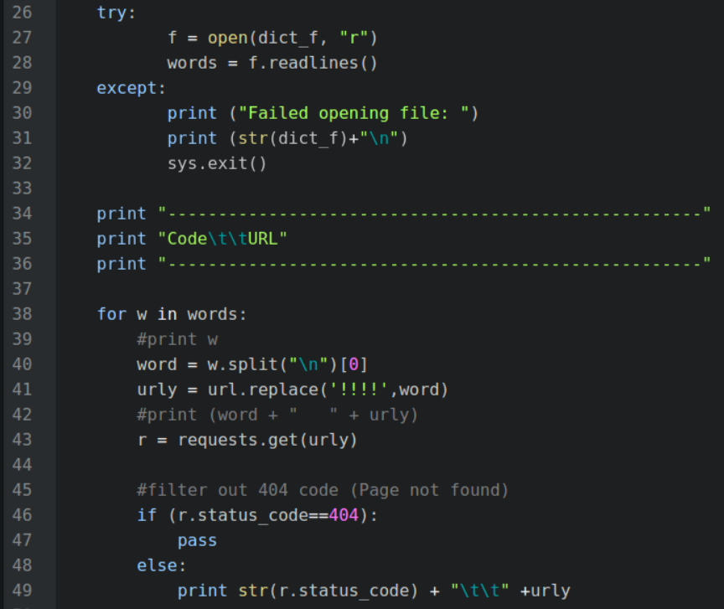
Step 3: bruteforce-1.2.py – Do not print those results that have status code 404

Slide 14
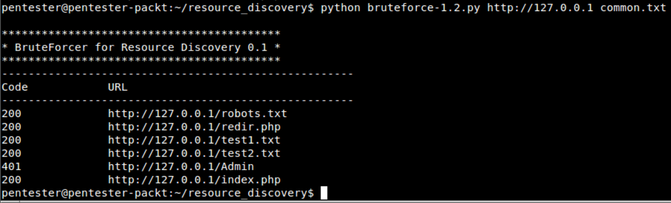
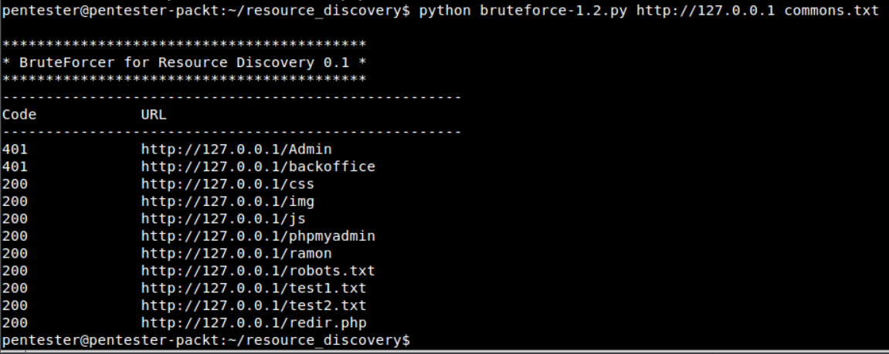
Step 3: bruteforce-1.2.py – Output
Redirection page. Lets us visit it in browser

Slide 15
URL redirection
URL redirection (also called URL forwarding), is a technique for making a web page available under more than one URL address.
When a web browser attempts to open a URL that has been redirected, a page with a different URL is opened.
URL redirection may be needed for various reasons:
for URL shortening
to prevent broken links when web pages are moved
to allow multiple domain names belonging to the same company (or organization) to refer to a single web site.
Ex. wikipedia.com and wikipedia.net are automatically redirected to wikipedia.org
for hostile purposes such as phishing attacks or malware distribution

Slide 16
URL redirection and resource discovery
For discovering resources, detecting URL redirection is important
Instead of saving redirect links, we want to save those urls where the redirects were taking us.

Slide 17
Redirect status codes and characteristics
HTTP Status Code | HTTP Version | Temporary / Permanent
301 | HTTP/1.0 | Permanent: The page has moved permanently
302 | HTTP/1.0 | Temporary: The page has moved temporarily
303 | HTTP/1.1 | Temporary: The page has moved temporarily
307 | HTTP/1.1 | Temporary: The page has moved temporarily
308 | HTTP/1.1 | Permanent: The page has moved permanently

Slide 18
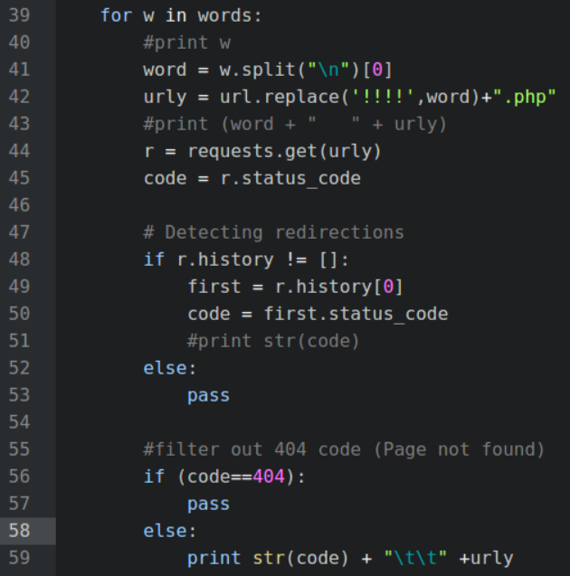
Step 4: bruteforce-1.3.py – Detecting Redirections

Slide 19
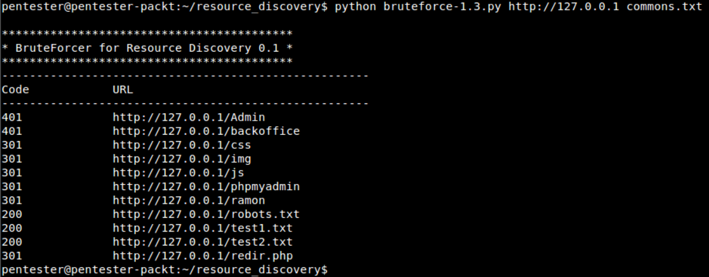
Step 4: bruteforce-1.3.py – output

Slide 20
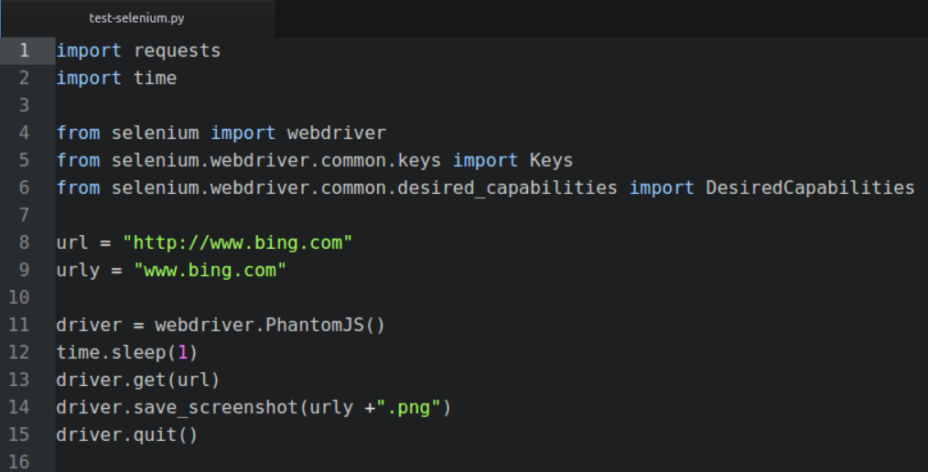
Step 5: bruteforce-1.4.py – Taking snapshots
First a simple example:

Slide 21


Step 5: bruteforce-1.4.py – Taking snapshots
Taking snapshot of every resource returning 200 status code
A way to speed up the analysis of big apps or when testing multiple apps in a short period of time
Needed libraries are:
Selenium web driver for Python and Phantom JS
Selenium web driver is a tool used to automate web browsers programmatically
PhantomJS is a headless browser
http://phantomjs.org/
https://www.seleniumhq.org/

Slide 22
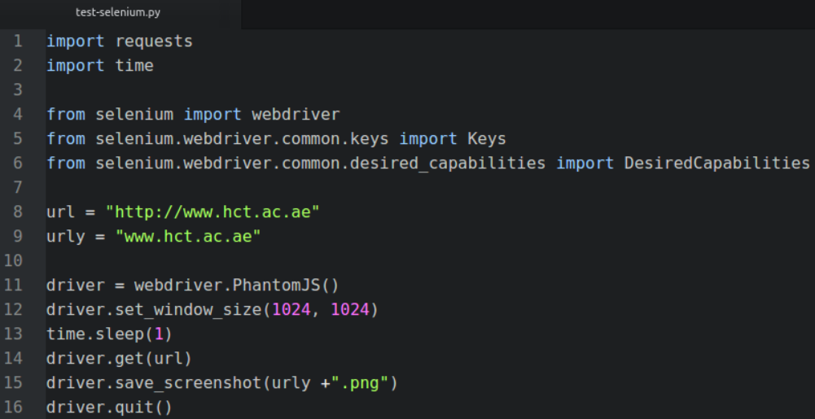
Step 5: bruteforce-1.4.py – Taking snapshots
A test example
Try this instead: driver = webdriver.Firefox()

Slide 23
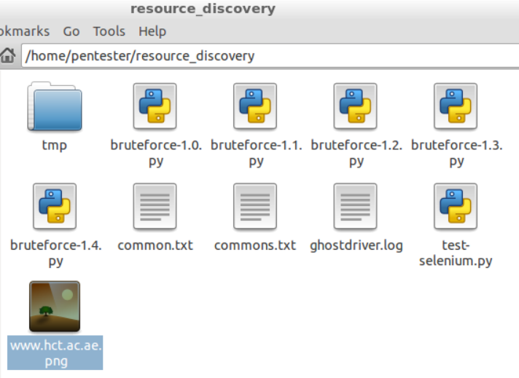

Step 5: bruteforce-1.4.py – Taking snapshots
A test example
$ python test-selenium.py

Slide 24
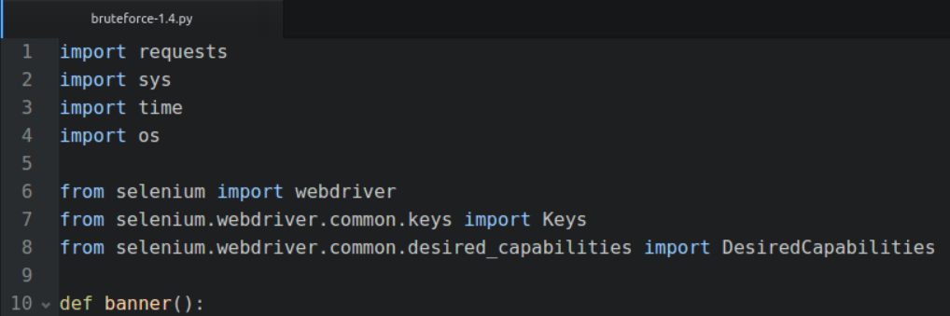
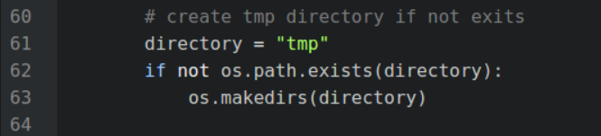
Step 5: bruteforce-1.4.py – Taking snapshots

Slide 25
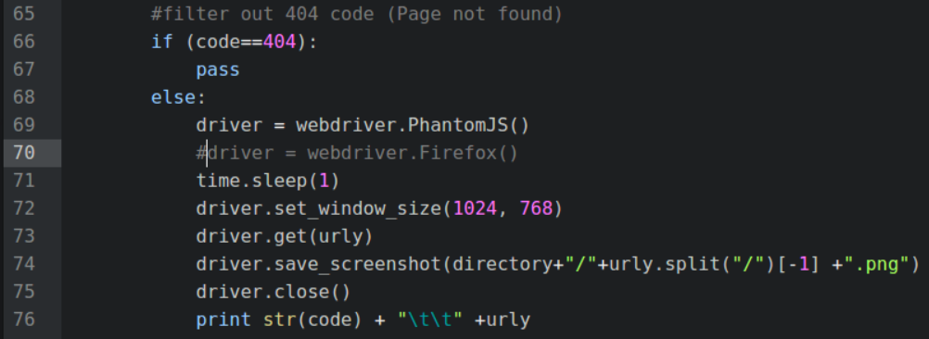
Step 5: bruteforce-1.4.py – Taking snapshots

Slide 26
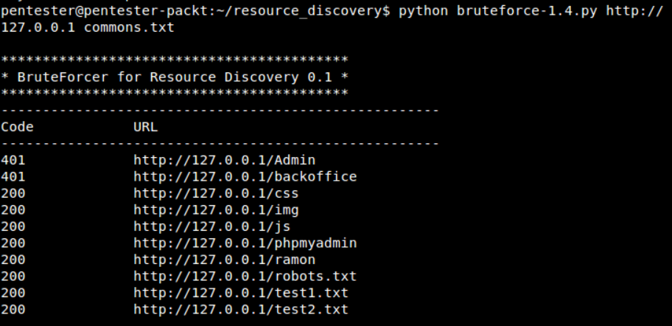
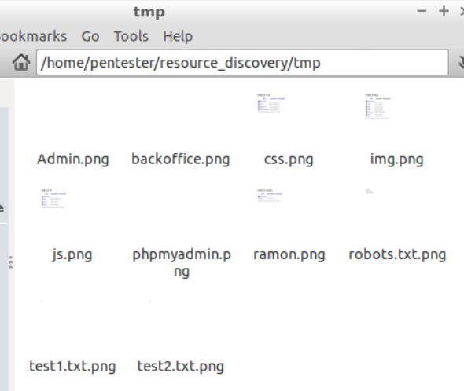
Step 5: bruteforce-1.4.py – Output

